Slide 1
"Cinema Ticket Sales Analysis: Clustering, Classification, and Prediction"
Done by:
Zayed Aziz Ahmed Alyafei Ahmed Ali Salem Alebri

Slide 2
Introduction:
This presentation explores cinema ticket sales data to uncover patterns and trends. We’ll use techniques like clustering, classification, and regression to analyze factors like ticket prices, sales, and occupancy rates. The goal is to understand what affects cinema performance and how we can predict sales and prices to improve business decisions.
Key points include:
Data Overview: A quick look at the key statistics.
Visualizing Trends: Exploring how ticket prices and sales are spread out.
Clustering: Grouping cinemas based on their performance.
Prediction Models: Using data to predict future sales and ticket prices.
Testing Hypotheses: Checking relationships between sales, occupancy, and other factors.

Slide 3
Identify the type and purpose of the machine learning algorithm to be implemented for the chosen dataset:
This project applies three main types of machine learning algorithms:
Regression: To predict continuous variables like ticket sales or ticket price based on features like cinema capacity and occupancy percentage.
Classification: To categorize cinemas or ticket sales into groups such as High Sales or Low Sales based on certain thresholds (e.g., occupancy percentage > 70% means High Sales).
Clustering: To find patterns and group cinemas based on their ticket prices, sales performance, and occupancy. This helps in understanding how different cinemas perform relative to each other.

Slide 4
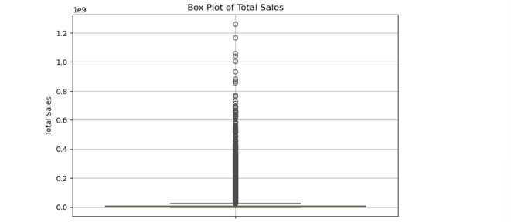
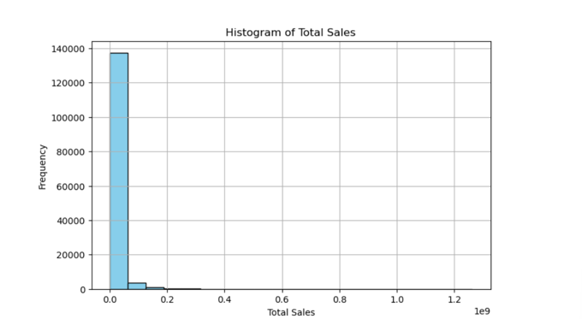
Data Visualization
Box Plot of Total Sales: Shows that most cinemas have low sales, with a few having very high sales (outliers).
Histogram of Total Sales: Most cinemas have low sales, while a few have very high sales.

Slide 5
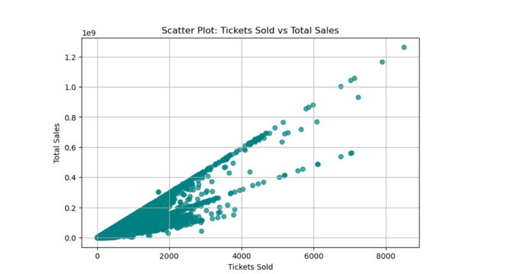
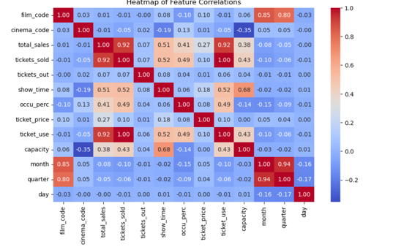
Data Visualization
Scatter Plot: Tickets Sold vs. Total Sales: Shows that higher ticket sales lead to higher total sales.
Correlation Heatmap: Strong correlation between total sales and tickets sold; ticket price and sales are moderately related.

Slide 6
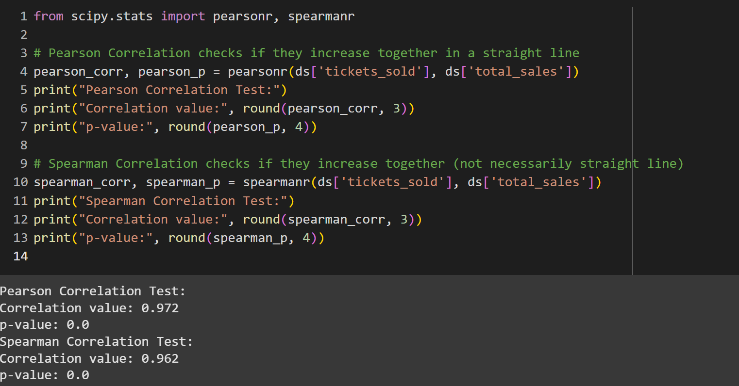
Correlation Tests: Pearson & Spearman
Pearson Correlation (0.972): Shows a strong linear relationship between tickets sold and total sales.
Spearman Correlation (0.962): Shows a strong relationship, though not necessarily linear.
Both tests indicate a significant and strong connection between ticket sales and total sales.

Slide 7
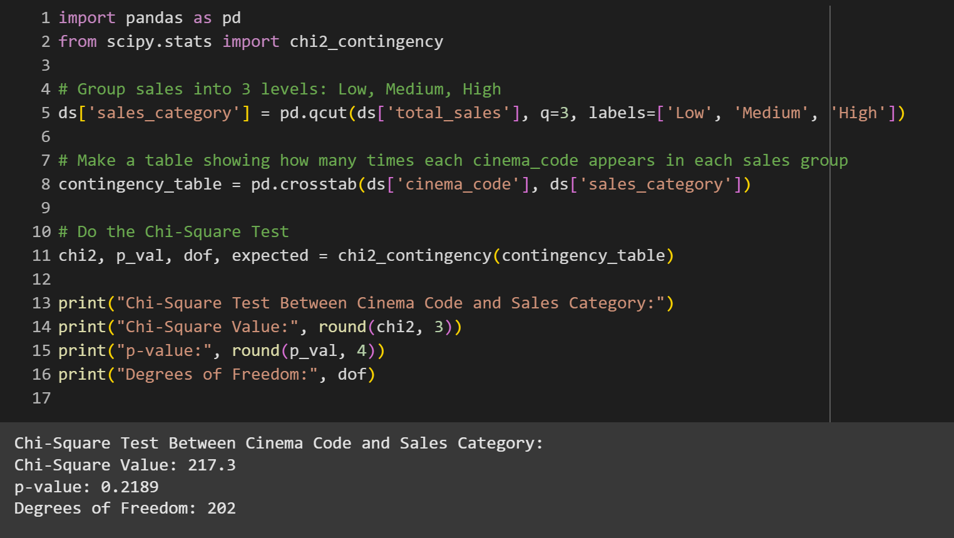
hypothesis testing using the Chi-Square Test
Chi-Square Value: 217.3
p-value: 0.2189
Degrees of Freedom: 202
Conclusion: Since the p-value (0.2189) is greater than 0.05, we fail to reject the null hypothesis. This means there is no significant relationship between cinema code and sales category

Slide 8
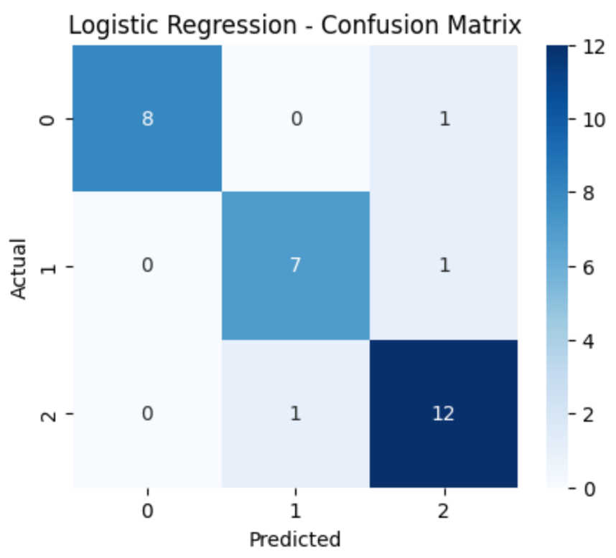
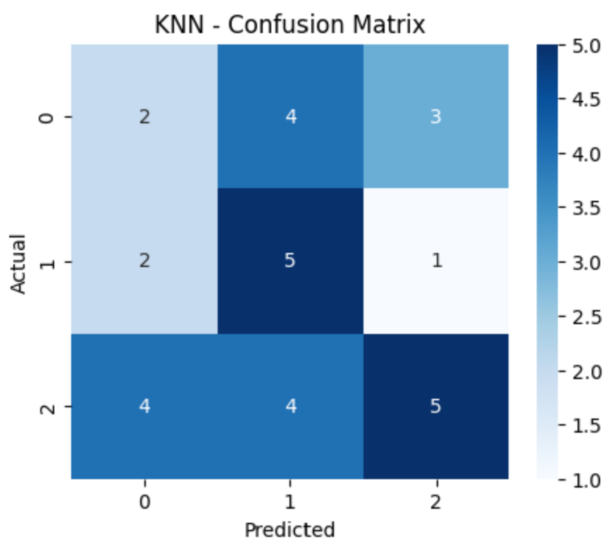
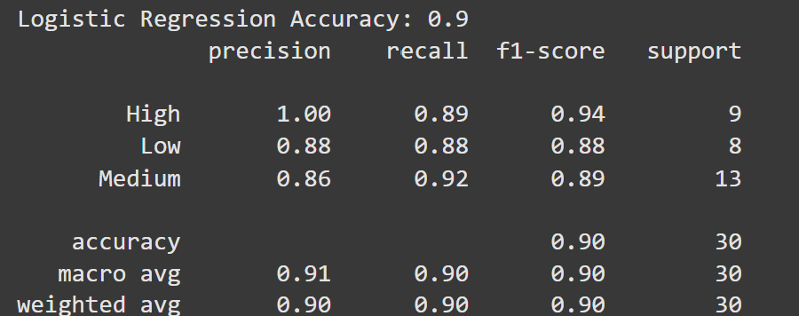
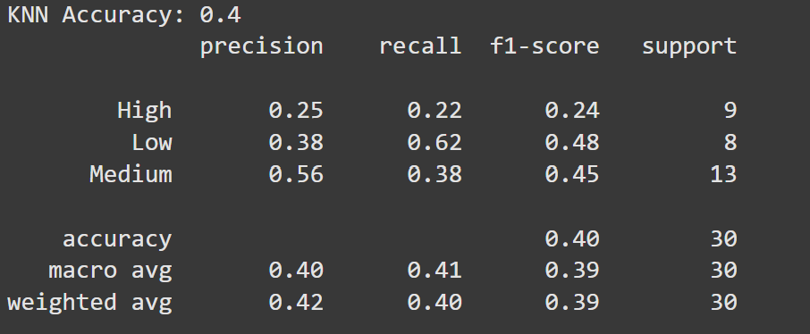
Model Evaluation: Logistic Regression vs. KNN

Slide 9
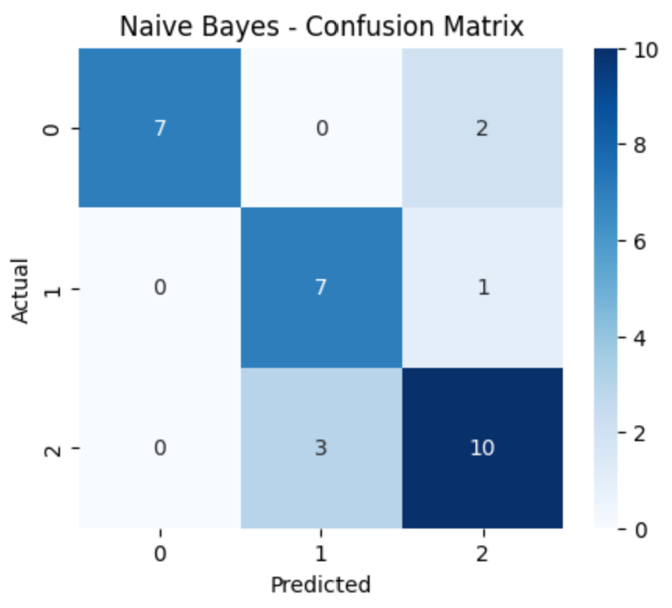
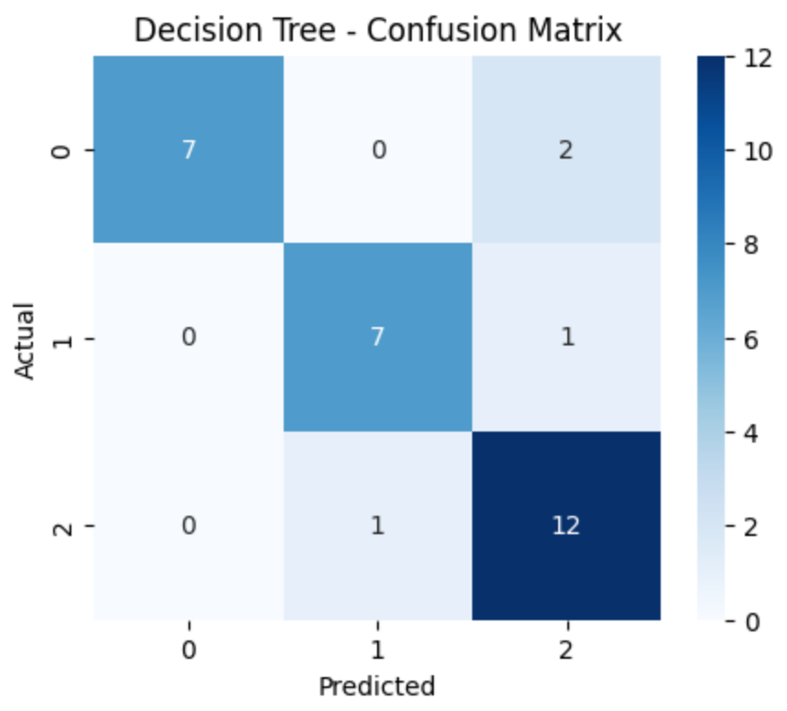
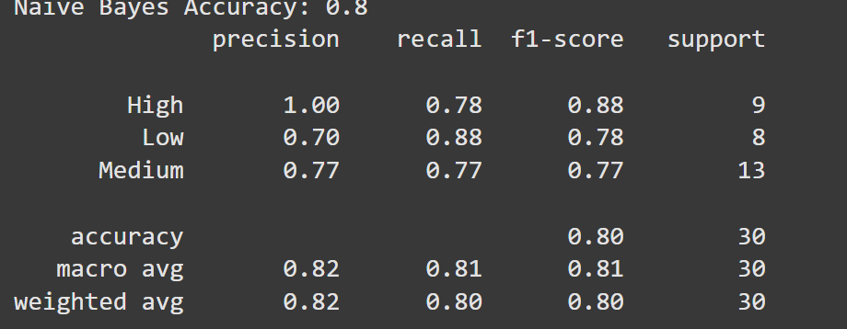
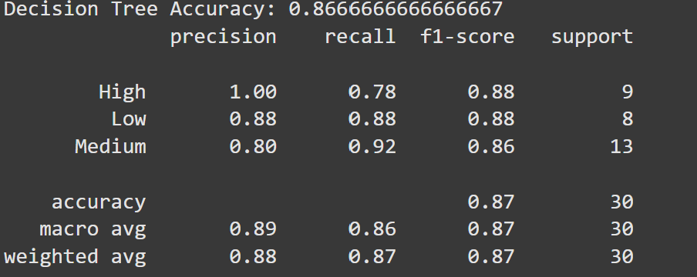
Model Evaluation: Naive Bayes vs. Decision Tree

Slide 10
Classification Model
Goal: Predict the sales category (High, Medium, Low) using features like ticket sales and occupancy.
Best Model: Decision Tree with the highest accuracy (86.67%) and strong precision/recall.
Key:
Accuracy: Percentage of correct predictions.
Precision & Recall: Measure of how well the model predicts each category.

Slide 11
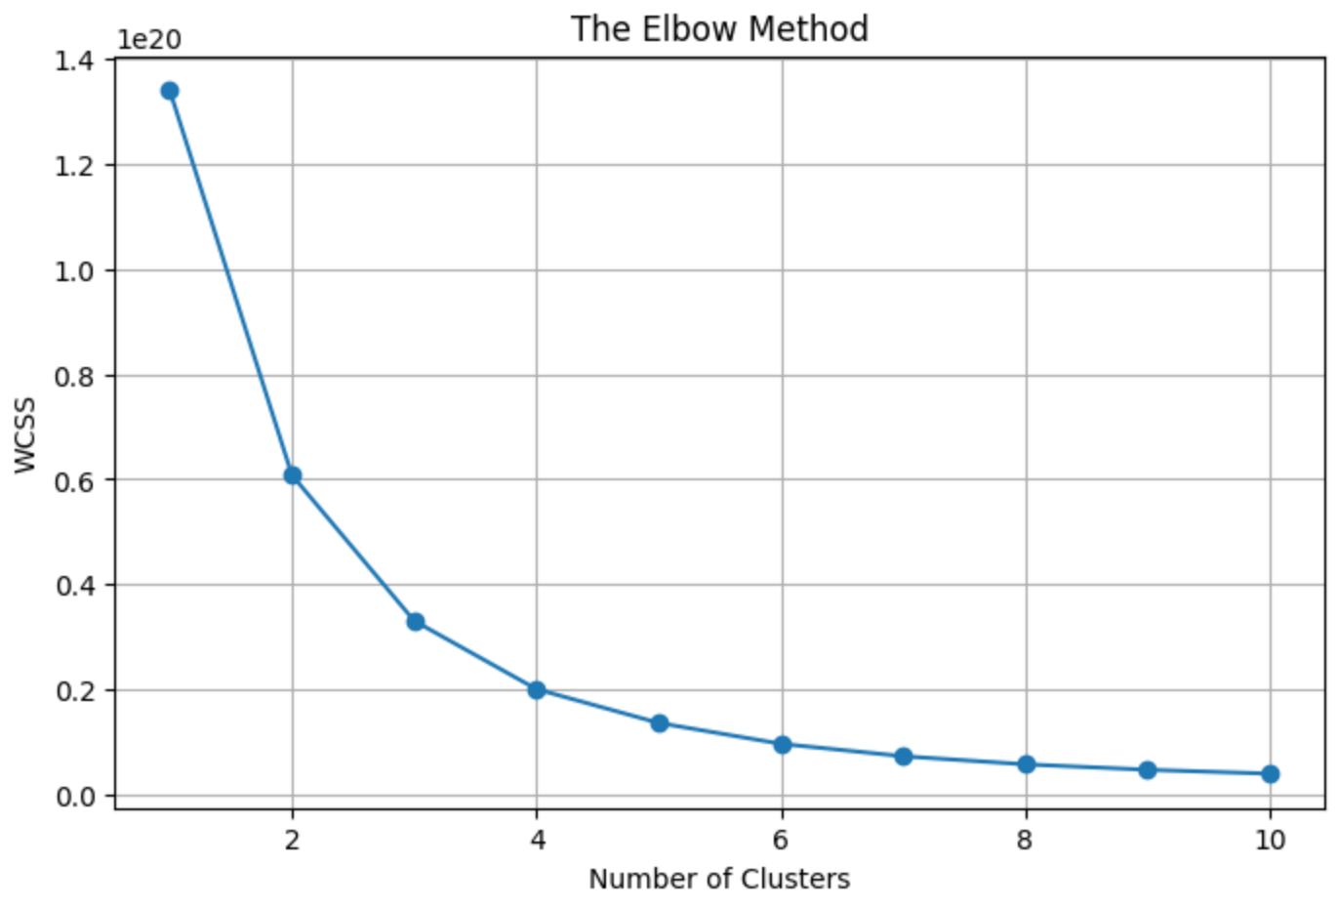
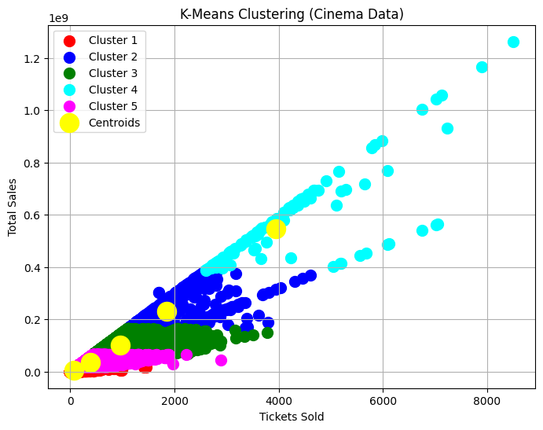
Clustering Analysis
Elbow Method: The optimal number of clusters is 5, as shown by the elbow in the graph.
K-Means Clustering: The plot shows 5 clusters based on ticket sales and total sales, with centroids representing the center of each group.

Slide 12
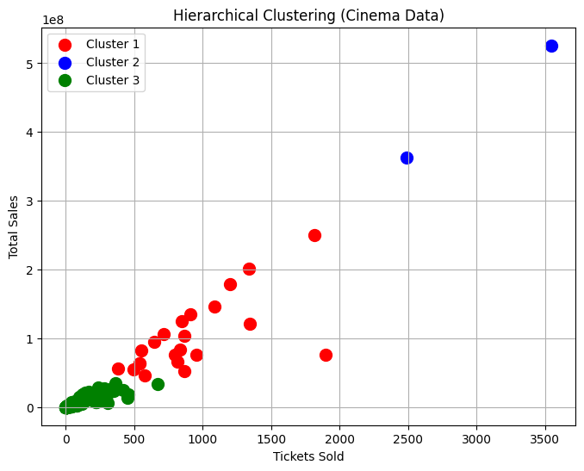
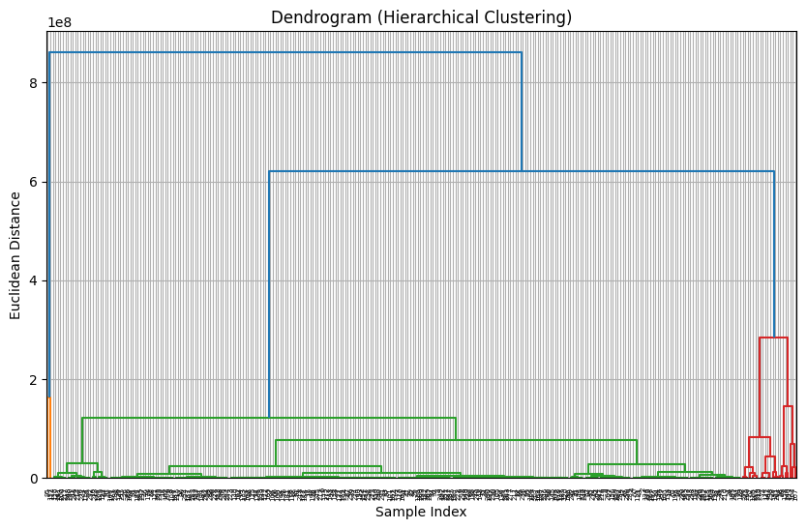
Clustering Analysis
Dendrogram: Shows the optimal number of clusters is 3, based on where the major splits occur.
Hierarchical Clustering: The scatter plot shows 3 clusters based on total sales and tickets sold.

Slide 13
Conclusion
This project analyzed cinema ticket sales using different models. Clustering helped group cinemas based on sales and ticket performance. Regression predicted sales, and classification categorized cinemas into high, medium, or low sales. The models showed that Decision Tree and Logistic Regression worked best for predicting sales categories.
These results can help improve cinema sales strategies and operations.

